Slide 1
CS-0401
INTERMEDIATE PROGRAMMING USING JAVA
Prof. Dr. Paulo Brasko Ferreira
Spring 2018

Slide 2
Chapter 5 Methods

Slide 3
Chapter 5 Presentation Outline
Introduction to Methods
General form of a method
Access type
Modifiers
Returning value
Names
Input arguments
Examples
Calling a method
Using the method returned value

Slide 4
Chapter 5 Presentation Outline
Differences between local and global variables
Initializing local/global variables with parameter values
Modifying an input parameter inside the method
Primitive versus Object variables
Using the modifier final in the input arguments
Calling methods that throw exceptions
Method documentation using Java Doc tool

Slide 5
Introduction to Methods

Slide 6
Introduction to Methods
What is best for my company?
Having a single person to handle all the tasks?
Having a team of specialized persons in each area?

Slide 7
Introduction to Methods
What is best for my program?
To have a single main() method that handles all code tasks
To have a set of methods, each one handling a specific task

Slide 8
Methods and Method Calls
If programs are short
We can write the code as one contiguous segment
The logic is probably simple
There are not too many variables
Not too likely to make a lot of errors
As programs get longer
Programming in a single segment gets more and more difficult
Logic is more complex
Many variables / expressions / control statements.

Slide 9
Method
Start
statements
Call method A
Method A
statements
statements
Call Method B
Method B
statements
Method C
statements
statements
Call Method B
End
Notes:
System.out.println(“Here is a message to output”);
System.out.println(“Printing something else”);
// Note that we don’t need to know how the println() method works in order to use it

Slide 10
Advantages of Methods
The program provides all information in the output as expected, but the numbers are wrong
Easy to debug
Easy to work as a team
An access to a database? I can create a new method for that
Easy to add new functionality
Testing the code
Avoid code duplication
Program with one method handling everything:
Get inputs
Validate inputs
Calculations
Show Results
Get Inputs
I did the implementation of “Calculations” method, I will take a look at it!
Validate Inputs
Calculations
Show Results

Slide 11
Functional Abstraction
Methods provide us with functional abstraction
We do not need to know all of the implementation details of the methods in order to use them
We simply need to know
What arguments (parameters) we must provide
What the effect of the method is (i.e. what does it do?)
double root = Math.sqrt(9.0);
This allows programmers to easily use methods that they did not write

Slide 12
The General Form of a Java Method

Slide 13
Examples in the Real World

Slide 14
Real World Example:
You call the mechanic (or you drive to his workplace).
You give your broken car to the mechanic.
The mechanic does his “magic” and returns the fixed car back to you when he is done.
Programming World:
Calling a method with an input parameter
The method returns something back when it is done.
Real World Example:
You give a soft drink to a marathon runner
You do not get anything back from the runner.
Programming World:
Calling a method with an input (water, beer, OJ).
The method does not return anything back to you.
Real World Example:
You turn your bedroom lights off.
You don’t need to give anything to the light switch
The light switch does not give anything back to you
Programming World:
Calling a method with no input.
The method does not return anything back to you.

Slide 15
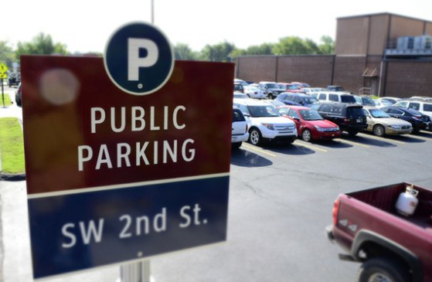
Real World Example:
Anyone can park in a public parking lot, such as the Shopping Mall parking
Programming World:
A public method can be called by not only other methods within the class it has been defined, but also by any other external class objects
Real World Example:
Only hotel guests can park in the hotel private parking lot
Programming World:
A private method can be only called by other methods within the class it belongs to. No outside calls are permitted
Real World Example:
Marriott Group owns many other hotels. Its members have privileges in any of its hotels (not for the general public)
Programming World:
A protected method can be called by any class inside a package (package is a group of classes)

Slide 16
The Main Elements of a Method (*)
<pt> <mod> <rt> <mn> (list of <at an>) {
java statements;
return ro;
}
Where: pt = permission type: private, public, protected
mod = static, final, or nothing
rt = object returned type (int, double, car)
mn = method name (remember camelCase)
at = argument type (int, double, car, or empty)
an = argument name (remember camelCase)
ro = returned object or variable value (or nothing)
(*) commands in yellow means mandatory entry

Slide 17
Method Access Type

Slide 18
<pt> <mod> <rt> <mn> (list of <at an>) {
statements;
return returnedValueOrObject;
}
pt = permission type: private, public, protected
private: The method can be called only by
statements from within the class this method has been defined
public: as the name suggest, the method can be called by statements in any other class any other class
protected: the method can be called by classes that are in the same “package”

Slide 19
Method Modifiers

Slide 20
<pt> <mod> <rt> <mn> (list of <at an>) {
statements;
return returnedValueOrObject;
}
mod = modifiers: static, final, or no value
static: The method is called by using the Class name instead of the object’s name
Math.abs(-10); // Math is the CLASS name
no value: The method shall be called through the
class object
String name1 = “John”, name2 = “”;
String.isEmpty(); // wrong! It does not make any sense
name2.isEmpty(); // is name2 content empty?
final: The method cannot be overridden, i.e., it is final for modification
Example: Math.cos()

Slide 21
Method Return Value

Slide 22
<pt> <mod> <rt> <mn> (list of <at an>) {
statements;
return returnedValueOrObject;
}
rt = returned value type: int, double, String, void, Elephant
a) Specifies what kind of returning value the method will send back to the statement that has called it.
b) The method is consider a:
i) Function, if it returns something
double a = Math.abs(-10);
ii) Procedure, if it does not return anything
double a = System.out.println(“Hello World”);
c) The method can return ONLY one “thing” back!

Slide 23
Returning examples
private void printCompanyPolicy() {
System.out.println(“Company Policies: “);
System.out.println(“No smoking in the premises”);
System.out.println(“No Zumba dancing in the classroom”);
}
private double computeRectangleArea(double base, double height) {
double area = base * height;
return area;
}
private String[] getFirstLastNames() {
String[] firstLastNameArray;
System.out.println(“Enter your first and last name);
String fullName = keyboard.nextLine();
firstLastNameArray = fullName.split(“ “);
return firstLastNameArray;
}

Slide 24
Method Name

Slide 25
<pt> <mod> <rt> <mn> (list of <at an>) {
statements;
return returnedValueOrObject;
}
Features on method names:
Use camelCase
private double average();
public void daysOfTheWeek();
Give meaningful names
private double getAveragedLabGrade();
public boolean isValidData();
public String[] getEmployeeFullName();
public void setEmployeeFullName(String[] employeeName);
protected void results();

Slide 26
Method Arguments

Slide 27
<pt> <mod> <rt> <mn> (list of <at an>) {
statements;
return returnedValueOrObject;
}
List of <at an>:
a list of arguments to be used by the method statements
the list is composed of pairs of (argument type and argument name)
the pairs in the list are separated by commas
the list can be empty
Examples:
showHelpInformation();
retrieveMinValue(int a, int b);
saveEmployeeData(String[] name, Elephant myPet, double weight);

Slide 28
Calling a Method and Using its returned value

Slide 29
Calling Methods Within your Class
// method defined inside your class
public double area( double radius) {
double ans = Math.PI * radius * radius;
return ans;
}
public int main() {
double rad = 2.0;
double theArea = area(rad);
}
Note #1: If method is called in same class in which it was defined, we don’t need to use the class name in the call
Note #2: parameter name does not need to have the same name as the argument name. They only must have the same type (double)
parameter
argument

Slide 30
Variables are passed by Value!!!

Slide 31
public int main() {
int value = 2;
System.out.println(“before method: “ + value);
doubleIt(value);
System.out.println(“after method: “ + value);
}
// method defined inside your class
public void doubleIt(int value) {
value = 2 * value;
System.out.println(“inside method: “ + value);
}
Answer: 2, 4, 2
Values are passed as copy!

Slide 32
2
Give a Copy to the method: 2
JVM makes a copy of the contents and place it inside a new box!
value
// method defined inside your class
public void doubleIt(int value) {
value = 2 * value;
System.out.println(“inside method: “ + value);
}
public int main() {
int value = 2;
System.out.println(“before method: “ + value);
doubleIt(value);
System.out.println(“after method: “ + value);
}
2
The method uses the new box (green) to double its value to 4, but the contents of the original box (in red) is still intact (2)
value

Slide 33
MethodExample01.java
If we pass an array as a method argument and the method changes its contents, will this change be noticed in the main program?

Slide 34
Copying an array into another array
int[] arrayA = { 1, 2, 3, 4};
System.out.println(arrayA);
int[] arrayB = arrayA;
System.out.println(arrayB);
arrayB[1] = -1;
System.out.println(arrayB);
System.out.println(arrayA);
Located at 0x3B memory position
1, 2, 3, 4
arrayB located at 0x6A
1, 2, 3, 4
1, -1, 3, 4
1, -1, 3, 4
 |  | A | B | C | D | E | F | G | H | I
1 |  | 12 | 0x3B | 3.14 | 0x3F | 7 | A | 13 | 2 | T
2 |  | 11.2 | 53.1 | 2 | 4 | 9 | a | W | z | 6
3 |  | 14 | 1 | 2 | 3 | 4 | T | h | i | s
4 |  | “ “ | i | s | “ “ | a | “ “ | l | o | n
5 |  | g | ” “ | s | t | r | i | n | g
6 |  | 0x3B
7
8
ArrayB

Slide 35
MethodExample01.java

Slide 36
Java Exceptions and Methods

Slide 37
Two ways of handling a problem (aka an “Exception”)
You ask her to decide what to do (you throw the problem (Exception) back to the method that called you)
Darling, could you buy my favorite shampoo, please???
Opss, the store does not have it! (Problem, aka Exception)
MethodExample03.java
You choose yourself an alternative shampoo (you handle/catch the Exception)

Slide 38
How Methods Threat Global and Local Variables

Slide 39
Scope

Slide 40
MethodExample02.java

Slide 41
Method Documentation

Slide 42
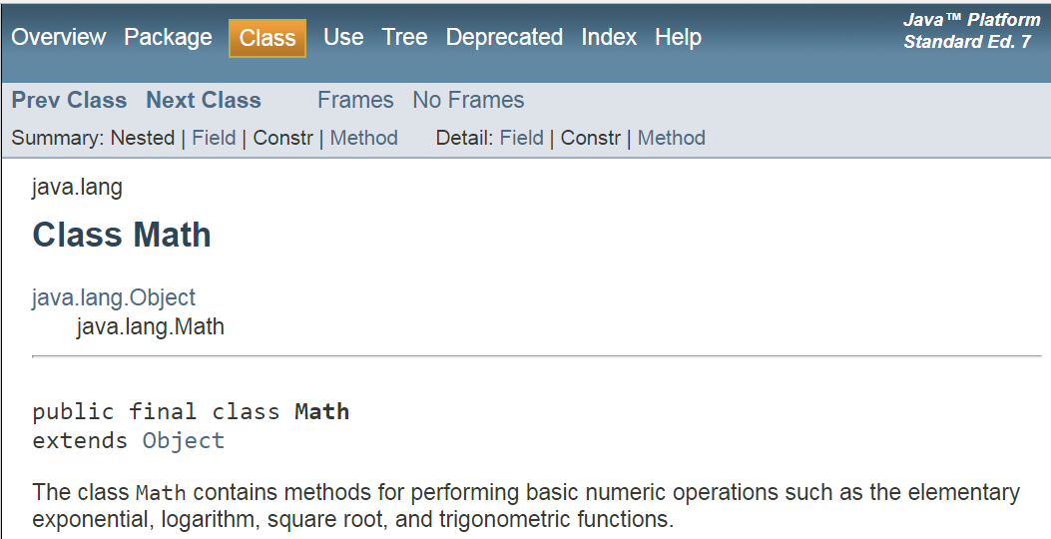

Slide 43
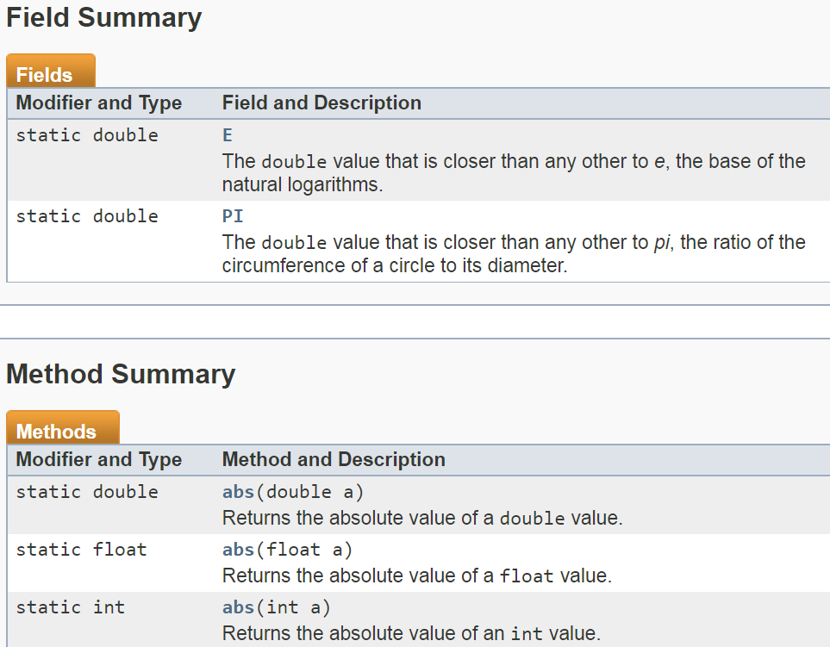

Slide 45
All this documentation is auto-generated for you using Javadocs Tool!!!
Javadoc looks at your code comments to generate that nice HTML documentation

Slide 46
Any Questions?

